Slide 1
Project Milestone

Slide 2

Audience for the presentation
Central Health Ministry
State Health Ministry
Senior Doctors
Healthcare Workers
Federal Authorities
Internal Securities Department

Slide 3
Dataset Description
COVID19 CASES IN TORONTO dataset contains information for all confirmed and probable cases reported to and managed by Toronto Public Health since the first case was reported in January 2020 till July 2020.
The data is extracted from the provincial communicable disease reporting system (iPHIS) and Toronto's custom COVID-19 case management system (CORES) and combined for reporting.
The dataset contains demographic, geographic, and severity of all cases reported to Toronto public Health.
The dataset gives a grasp of the age group and to what kind of treatment the patient was given in the time of crisis.

Slide 4
SUMMARY OF COVID 19 CASES IN TORONTO
Case Count * | 14911
Recovered Cases | 13195
Fatal Cases | 1121
Ever Hospitalized | 1848
Ever in ICU | 400
Currently Hospitalized | 151
Currently in ICU | 29
Percentage Male | 45.24%
Percentage Female | 53.04%
Most affected Age group | 50-59
Most affected Neighborhood | Glenfield Jane Heights
As of July 2020
* Includes confirmed and probable cases

Slide 5
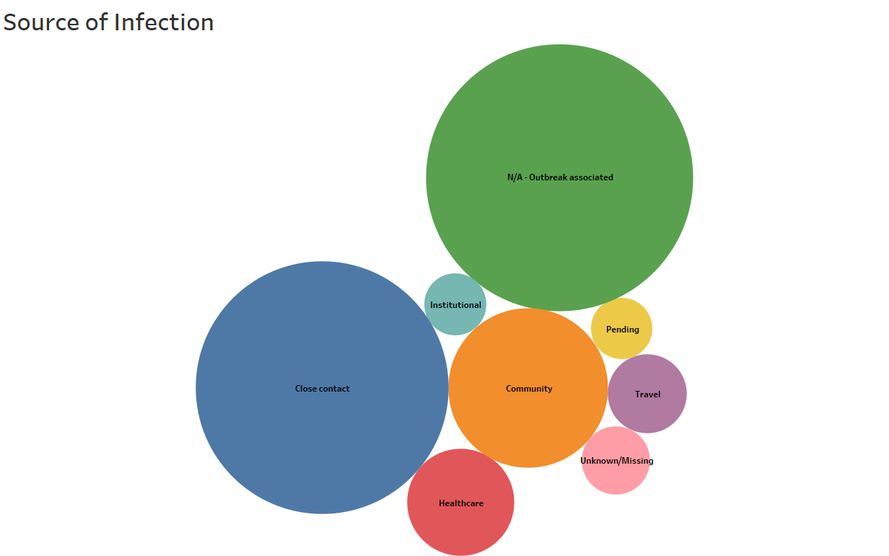

Slide 6
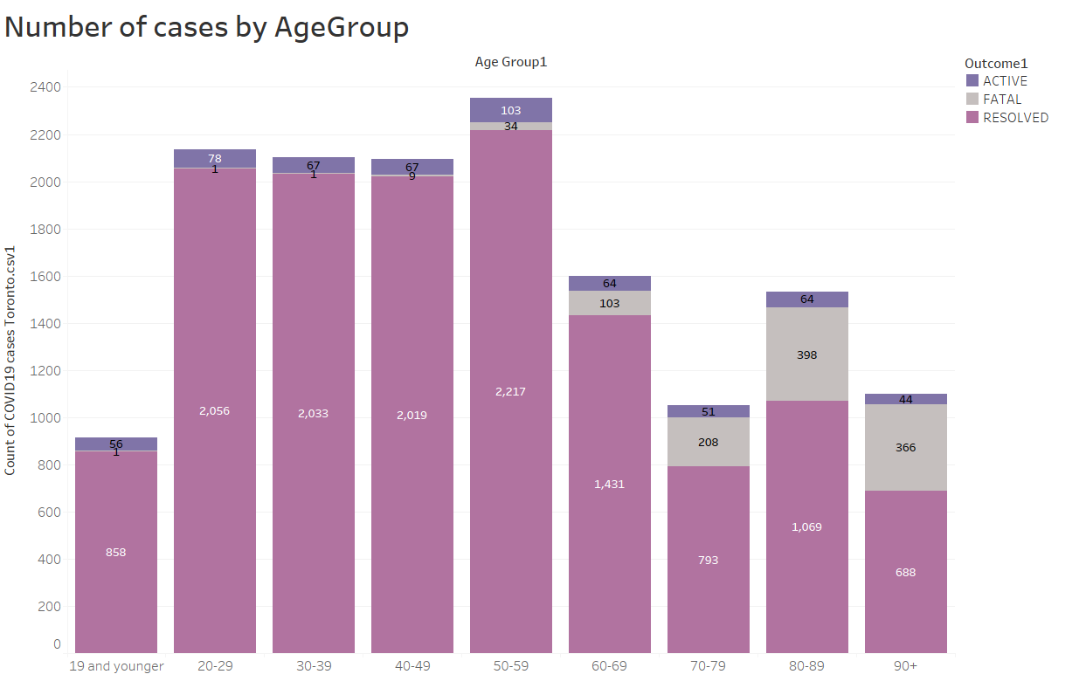

Slide 7
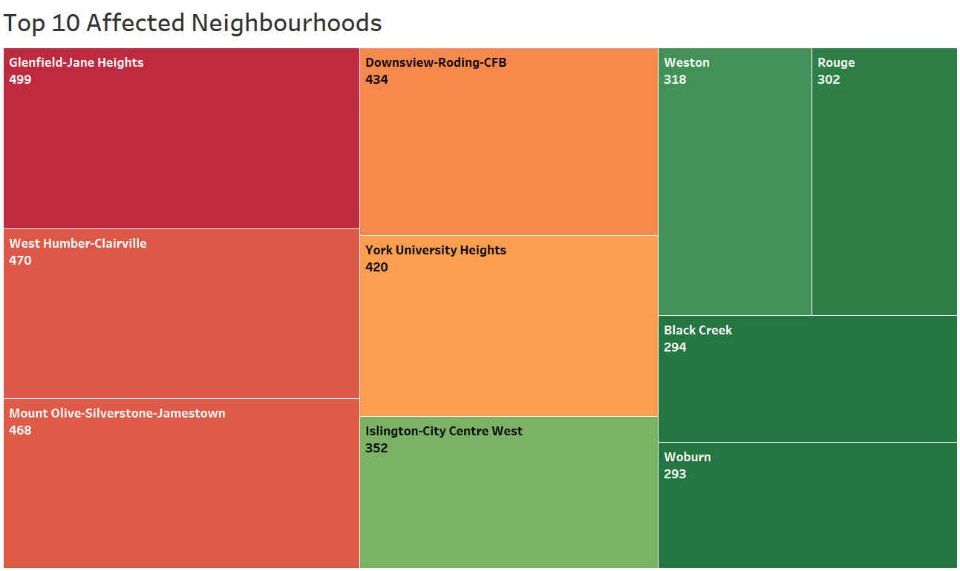

Slide 8
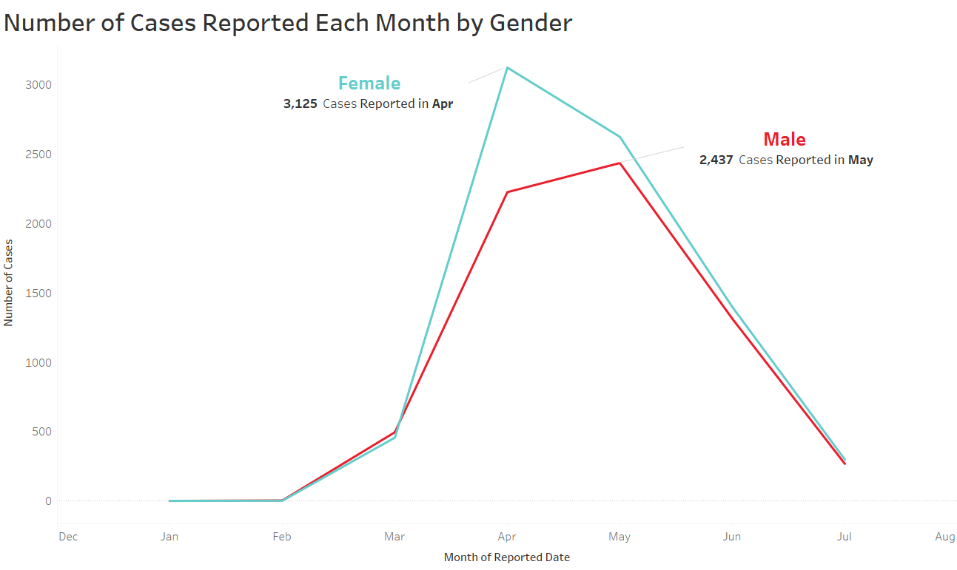

Slide 9
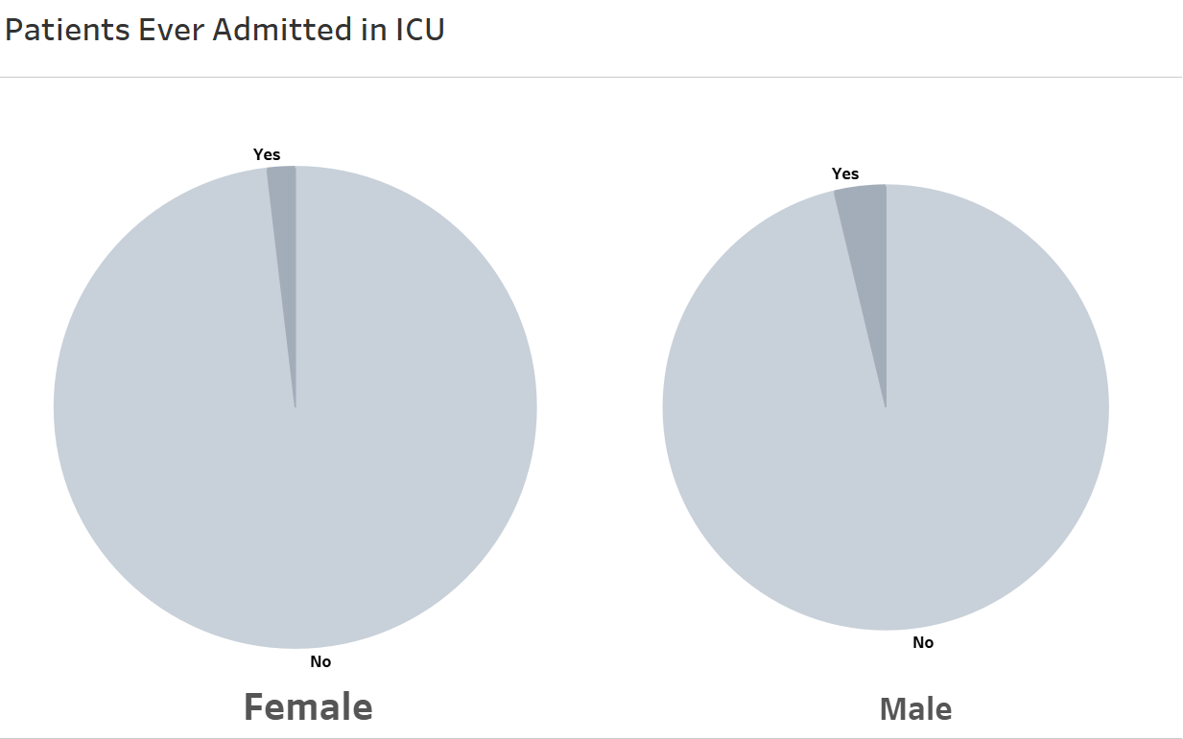

Slide 10
Analysis
Apart from the outbreak associated patients, the top sources of infection are infection due to close contact, community transmission and healthcare related transmission.
These sources make up to approximately 85% of the total cases in Toronto.
As the tree map suggests, these are the top 10 affected neighborhoods with Glenfield Jane Heights being the most affected one having 499 cases.
It can be seen that the Age group 50-59 is most affected by Covid-19 in Toronto, but it also has the most number of resolved cases.

Slide 11
Analysis
Age group 80-89 has the 4th lowest number of cases but it has the highest number of deaths.
The highest death rate is found in those who are 90+ (33.33%)
Number of cases reported for Female were the highest in April (3125) and were the highest for Male in May (2437).
852 Females and 987 Males were ever hospitalized and out of them 147 Females and 251 were in ICU.

Slide 12
Recommendations
Impose more restriction till the number of cases are decreased.
Make thermal screening mandatory at every shop.
Increase the use of sanitizers.
Hospitals should focus on the age groups which are most affected, especially those who are more vulnerable to the virus.
Prioritize the age group having higher fatality rate over the younger age groups and provide better facilities to them.

Slide 13
Recommendations
Find out the occupation of the people in the most affected neighborhoods, check whether there is a trend of people with outdoor jobs being infected more.
April & May had the highest number of cases for Female & Male, check for the events that happened during that time to make sure it does not happen again.
Create a centralized quarantine system as well as other methods to achieve effective isolation for individuals.
Rebuild the design & implementation of ways to address the social determinants of health for City of Toronto’s most vulnerable population.

Slide 14
THANK YOU
STAY SAFE, WEAR MASKS & MAINTAIN SOCIAL DISTANCING

